Slide 1
Cap Store
Module Name : Business Analysis
Trainee Name: Rahul Bilra
Team number : 3
Employee Id:1900113

Slide 2
Table Of Contents
About Cap store
Software Requirements
Module details
UI Screenshot

Slide 3
About Cap Store
Cap Store is a web based e-commerce website that allows users to buy or sell products. Users can view products from different categories and buy them. The user will be able to see products of similar category, sort them, compare them.
Cap Store also allows users to sell their products, they need to register on to the website and need to be authorized by the admin of Cap store. Cap store also has the facility to add third party merchants.
Cap store will be a website for Capgemini employees. To buy a product, customer has to select the product and add to his cart, customer can add or remove items in cart at anytime. In the end an invoice will be generated, The Customer has options of buying product either through Cash On Delivery or through online payments. Customer has a facility to return the products and can also give a review on them.

Slide 4
Software Requirements
Visual Studio Code : Angular-UI(Front End)
Spring Tool Suite : Spring data (Back End)
Oracle SQL Developer : Database Purposes

Slide 5
Module : BUSINESS ANALYSIS
Admin can generate business analysis at the end of some time period.
The Module is divided into different parts.
The first part describes the dispatch report of all products.
The Admin can search for dispatch report of a particular product by product id.
The other two parts shows the business report which depicts the revenue generated by a particular product or a particular merchant.

Slide 6
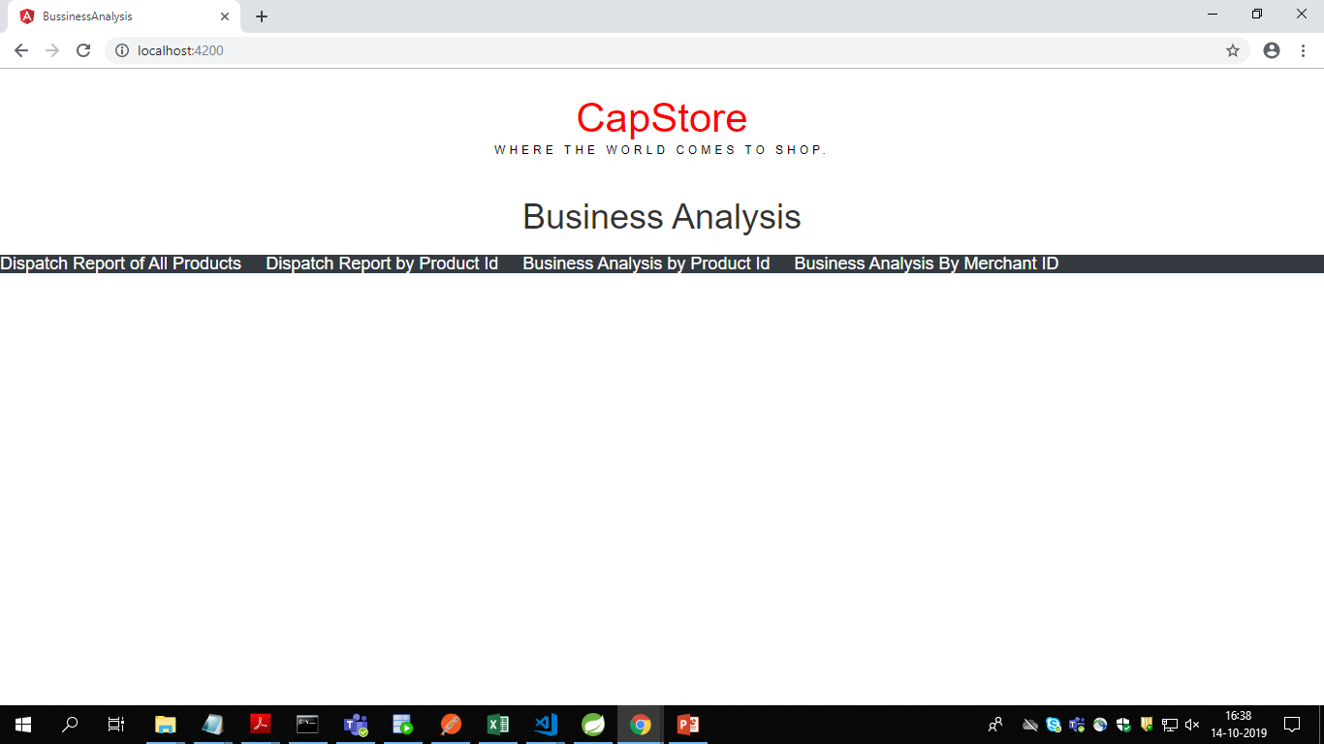
User Interface :The Main Page with Options-

Slide 7
Thank you

